Slide 1
Energy Efficiency Rebate Program

Slide 2
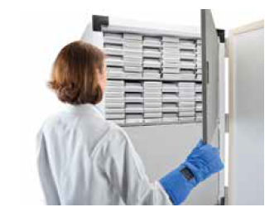
Agenda
Program Overview/Customer Benefits
Post Sale Requirements
Q&A

Slide 3
Instant Rebate for Energy Efficient ULT Freezers
In partnership with energy companies in CA & Energy Solutions, we can offer our UC customers $1,200 off the purchase price of a qualifying Thermo Fisher Scientific, energy efficient -80 freezer at the point of sale.
Instant rebates motivate the purchase of energy efficient equipment which helps reduce our customer’s energy costs.
Instant rebates minimize paperwork, which increases customer satisfaction and participation.
Instant rebate $1,200 goes directly to the lab versus account’s general account’s receivable/AR dept.
Notes:
To create a new presentation
Double-click or Open from PowerPoint > [xxxtemplate].potx file.
Start building in this template and save as a new presentation.
Avoid copy & paste or drag & drop of slides from other presentations in different templates. This often can cause master template conflicts and increased file sizes. Instead…
To leverage content from other presentations, (1) select just the content on a slide that you need (2) copy & paste into a [blank] slide in this template (3) Control pasted content appearance via the paste options button that appears immediately after a paste action and which provides the option to choose either “use destination formatting” or “maintain source formatting” of pasted content.
Applying New Template Theme to an Existing Presentation :
From the Design Tab in the ribbon, click on the “more” drop down arrow at the right of the theme ribbon
Select “Browse for Themes…”
Navigate to and select [xxxtemplate].potx file and click Apply
This will apply new Template Theme colors, fonts and layouts but will not include any of the content on the slide examples from the full template itself.
Reposition content and reapply or change layouts as needed.
Additional resources available on iConnect > Functions > Marketing > Resource Library

Slide 4
Eligible CA Customers
Current Authorized Utility Providers
Southern California Gas
Pacific Gas and Electric
San Diego Gas and Electric
Zip Code Lookup Tool
Identify authorized zip codes/customers
Use end user site/address/zip
Los Angles Power and Gas
Not currently approved/authorized
Seeking approval
Hopefully this year/early 2022

Slide 5
Program quoting guidelines
Fisher Scientific will receive a special price quote from Thermo Scientific (this is the only way to offer incentive)
Program will require customer information:
End user name & contact information (phone number + email address)
Exact address of ULT must be provided in case of audit by Energy Solutions (no warehouses, temporary locations, etc)
We will notify customer of potential onsite visit by Energy Solutions to audit ULT (not likely but possible)
TSX700 is not currently eligible for the energy rebate (hopefully added in 2022)
New pricing will reflect a $1200 discount off of published sell price to UC

Slide 6
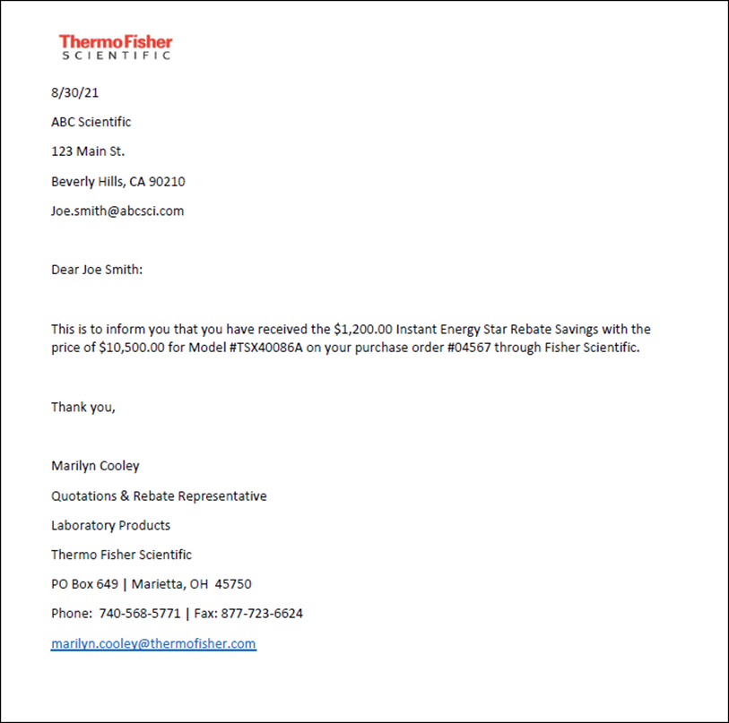
Post Sale Follow-up
Form letter regarding the rebate will be sent to the customer once the unit has shipped

Slide 7
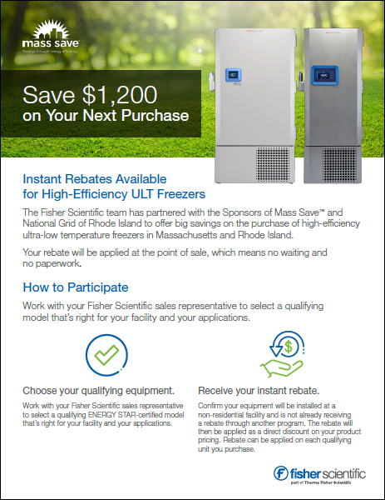
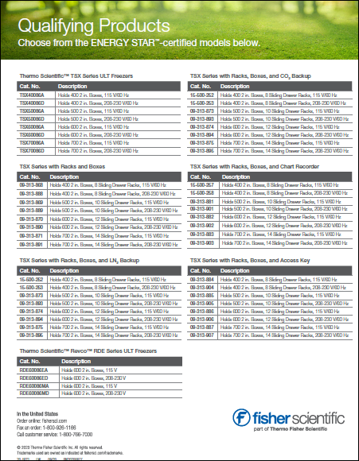
Coming Soon!
Customized program brochure for CA will be promoted to customers at each university

Slide 8
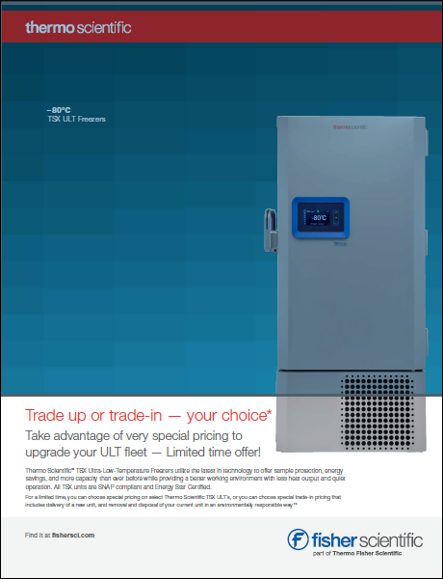
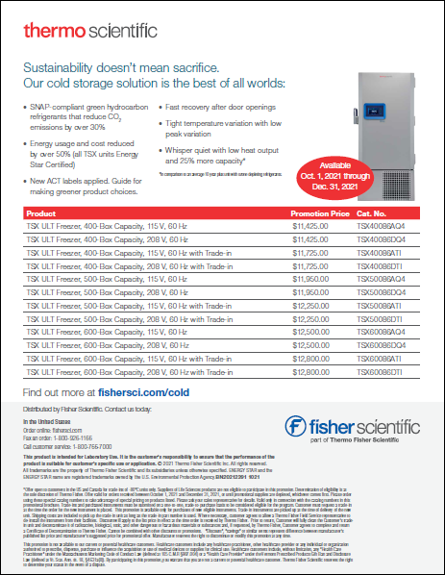
Fisher Scientific – Current/Active Promotion
Energy Solutions Incentive eligible with active/current Thermo Scientific Promotions
Example…..
TSX60086D
$13,112 - UC Current Price
$12,500 - Active Promo Price (thru 12/31/21)
$ 1,200 - Energy Solutions Rebate
$11,300 – Final UC Price
Using active promo and Energy Solutions Rebate

Slide 9
Comments/Questions
Thank You!

